Slide 1
Global Trends in Renewable Energy (2000-2010)
What factors influence a country’s move toward renewable energy?

Slide 2
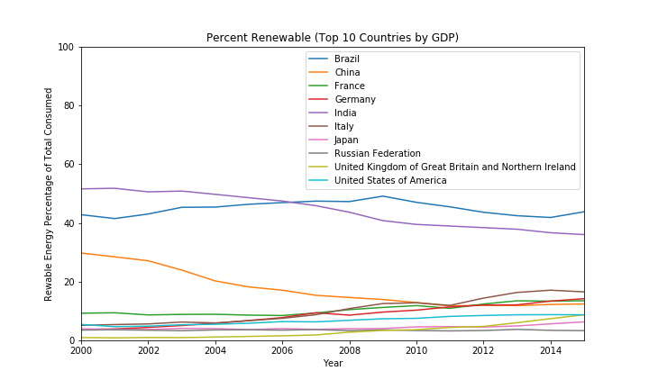

Slide 3
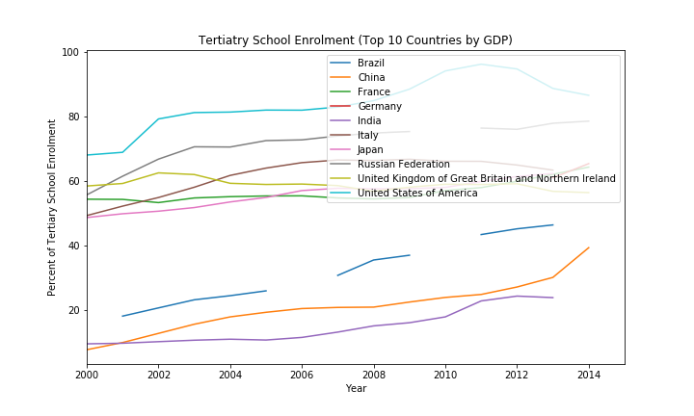

Slide 4
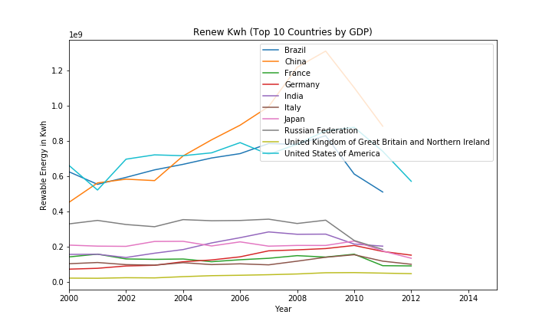

Slide 5
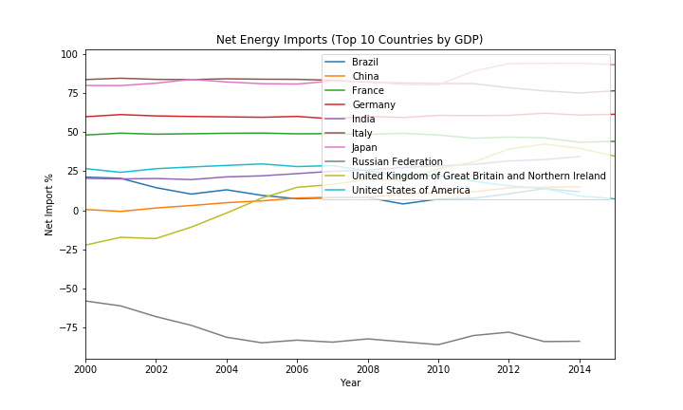

Slide 6
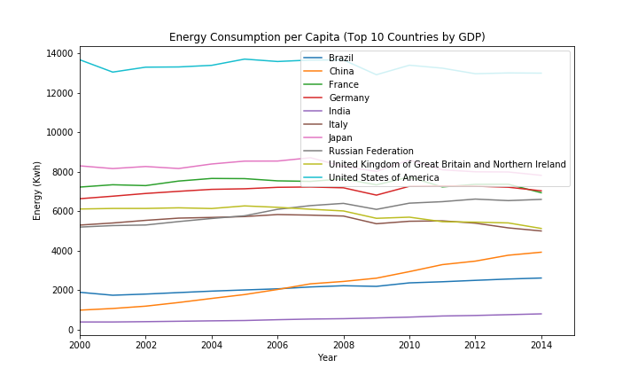

Slide 7
Challenges in the Process

